Slide 1
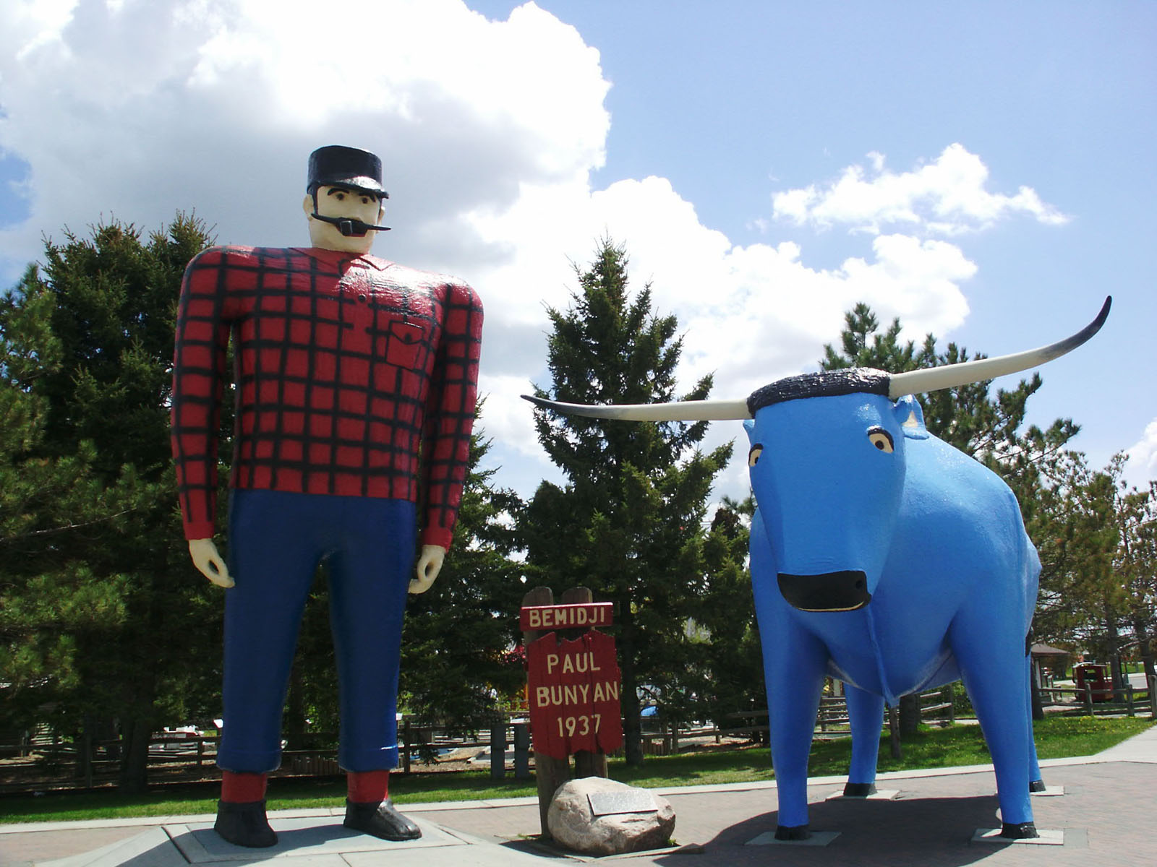
Member Orientation
Lions District 5M10
Notes:
Trainer Tip: Enter other information as you see fit, such as the name of the New Member Orientation trainer.

Slide 2
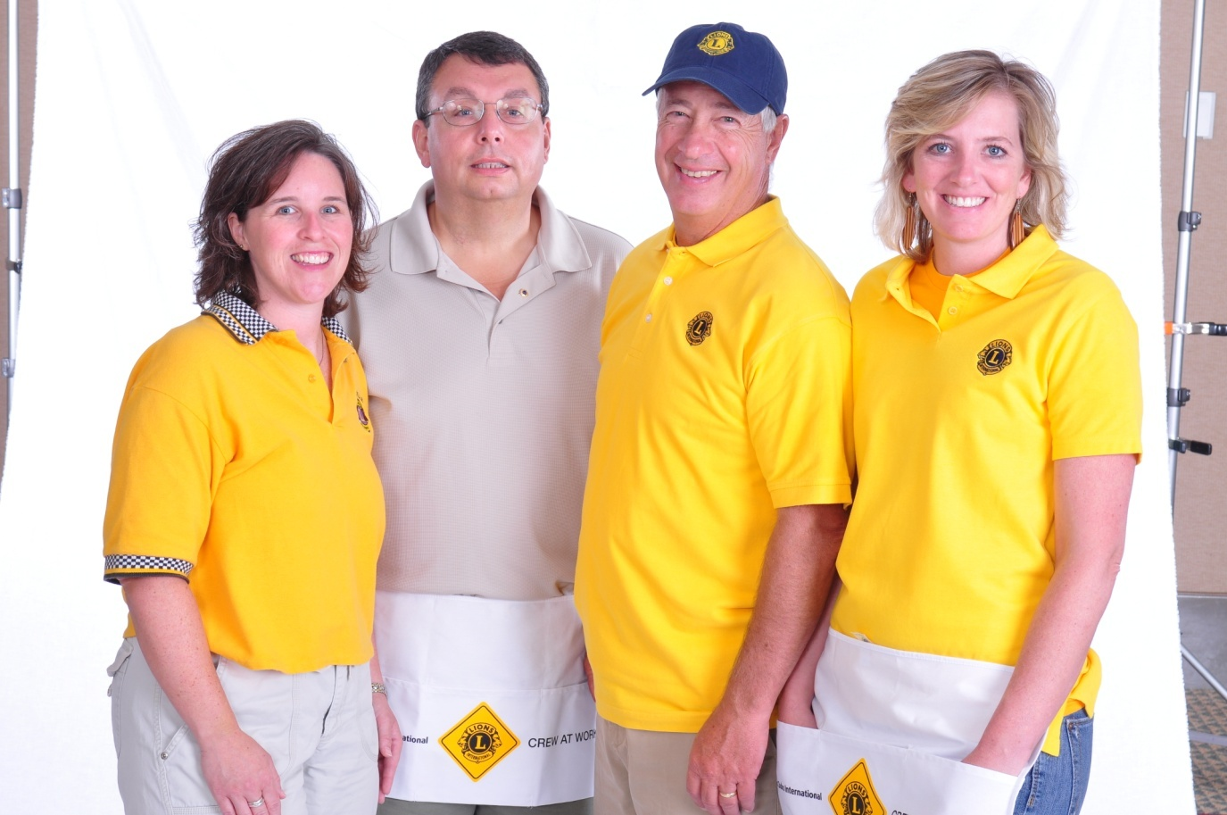
Who Lions Are
Lions are men and women dedicated to serving those in need, whether in their own community or around the world.
Nearly 1.5 million members
Over 200 countries
More than 46,000 clubs

Slide 3
Vision Statement: To be the global leader in community and humanitarian service.
Mission Statement: To empower volunteers to serve their communities, meet humanitarian needs, encourage peace and promote international understanding through Lions clubs.
Motto: “We Serve”
Code of Ethics: LCI has a code of ethics which set the standard that Lions should aspire to adhere to.
Purposes: LCI has a list of purposes to convey why Lions clubs exist.
Who Lions Are

Slide 4
Motto: “We Serve”
Five Pillars of Lions Clubs
Vision Diabetes
Hunger Childhood Cancer
Environment

Slide 5
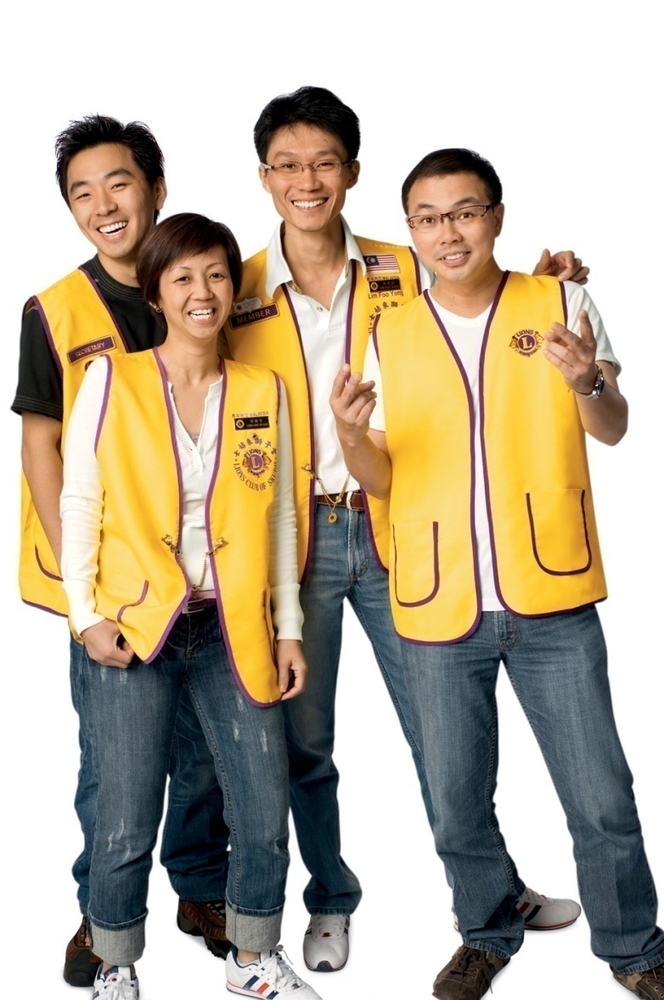
LIONS MOTTOS
WE SERVE (1954)
WHEREVER THERE’S A NEED—THERE’S A LION
WE CHANGE PEOPLE’S LIVES!

Slide 6
LIONS SLOGAN
L: Liberty
I: Intelligence
O: Our
N: Nation’s
S: Safety

Slide 7
Membership
The benefits of Lions Clubs membership are numerous, and include:
Helping those in need
Making a difference in your community
Having an impact on those in need worldwide
Developing leadership skills
Enhancing communication skills
Utilizing planning and organization skills
Working hands-on to meet community needs
Meeting new people
Opportunities to network
Opportunities to travel

Slide 8
Lions Clubs International

Slide 9
Name and Logo
The Lions logo consists of a gold “L” on a blue field surrounded by a gold circle.
On either side of the circle is the profile of a Lion’s Head, one looking back upon a proud past, and the other looking optimistically toward the future.
The official name of the association is
“The International Association of Lions Clubs,” or simply
“Lions Clubs International,” (LCI).
The name “LIONS’ was chosen in 1917
on a secret ballot over several others because
the Lion stood for:
STRENGTH; COURAGE; FIDELITY; and VITAL ACTION

Slide 10
Lions Clubs History
1917: Melvin Jones founded LCI.
1920: LCI becomes international with Canadian club.
1925: Helen Keller challenged Lions to become “knights of the blind.”
1945: LCI helped draft the United Nations Charter.
1957: The Leo Club Program is created.
1968: The Lions Clubs International Foundation is established.
1990: SightFirst is launched.
Today: Our international network has grown to include more than 200 countries and geographic areas.
1987: LCI became the first service club organization to admit women as members.

Slide 11
Lions Clubs History: Today
One Shot One Life: Eradicate Measles Campaign
LCI Forward: Strategic Plan—Impact 200 Million Lives by 2020-21
LCI Forward: Service; Visibility; Excellence; Membership
LCI Grants: Leadership Training & Increase and Retain Membership
LCI Campaign 100: Raise $300 Million—Expand Global Causes & Increase Service Impact
LCI Reading Action Program
Today: Our international network has grown to include more than 200 countries and geographic areas.

Slide 12
Organizational Structure
There are 750 districts with 35 or more clubs and at least 1,250 members in each district.
Each district has a district governor
Multiple districts are formed by two or more districts within a territory.
Our Multiple District: 5M
Our District: 5M10
Notes:
Trainer Tip: Consider adding additional information about your district and multiple district, such as the district governor’s name and the boundaries of your district and multiple district.

Slide 13
District and Multiple District

Slide 14
Multiple District 5M
International: Two Countries—Canada & United
States
2nd Largest Multi-District in North America— Minnesota; Manitoba; & NW Ontario
Two International Districts (Clubs in one District—
But clubs in Canada & U.S.
12 Districts – 5M1, 5M2, 5M3, 5M4, 5M5, 5M6, 5M7, 5M8, 5M9, 5M10, 5M11, 5M13
More than 665 Clubs
More than 22,000 members

Slide 15
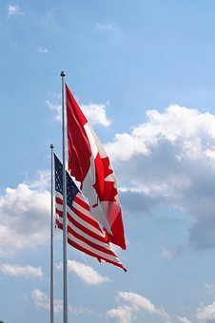
District 5M10: Minnesota & NW Ontario
Geographically Second Largest District in North America
18 Clubs in Ontario/ 32 Clubs in Minnesota
3 Regions – 8 Zones
45 Lions Clubs
4 Leo Clubs & 3 Campus Clubs
1,264 Lions Members, up from 1,188 7-1-18
Largest Clubs – Bemidji (107), Emo & District, Ontario (81),
Cap Baker in Grand Rapids (76) and Duluth (76)
Smallest Clubs – Ely (8), Pickle Lake (7), Marathon (3)

Slide 16
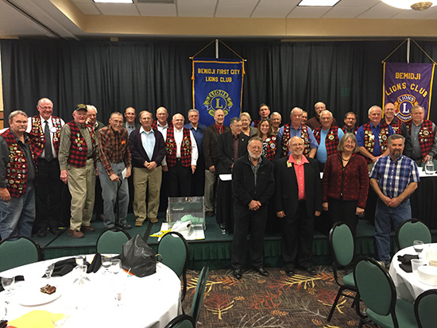
Traditions: Lions Clubs
Club Social Events
One or more annual Fundraising Events
Donations to a variety of Charitable Causes
Community Service Projects
Collaboration with other organizations

Slide 17
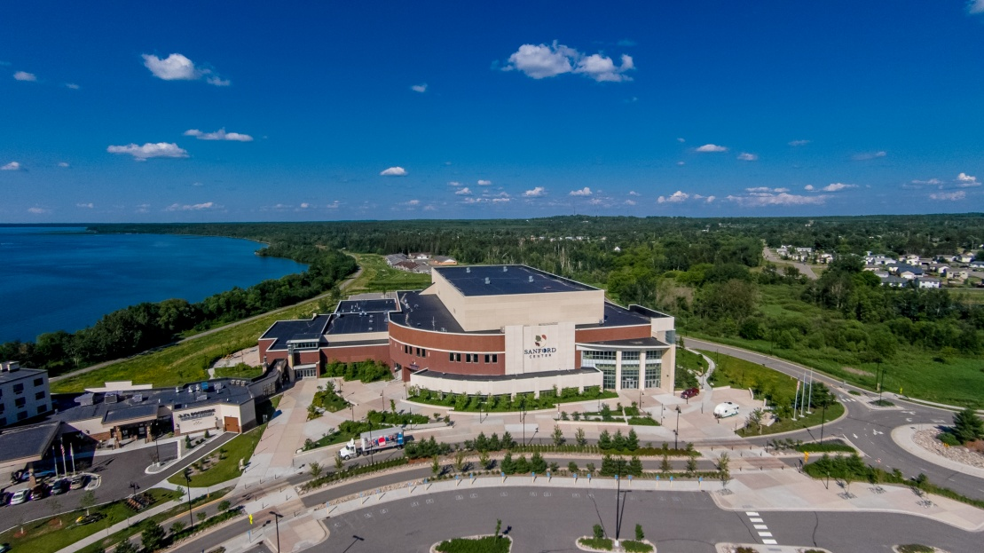
Traditions: 5M10 Lions Club
District 5M10 Mid-Winter Conventions: Late January
Multiple District MD5M Conventions:—April
International Convention: June or July

Slide 18
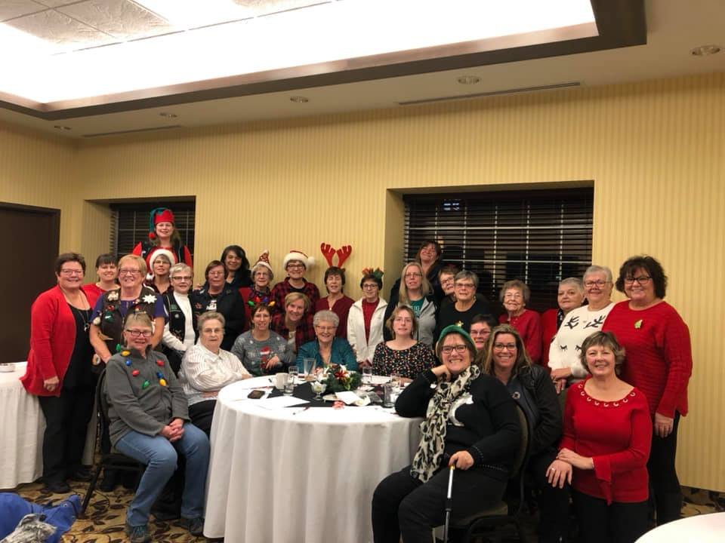
Elections: 5M10 Lions Clubs
Each club has the option of appointing a nomination committee. Each Lions Club Nominates and Elects Officers according to their Constitution & By-laws and traditions.
Some Club officers are elected annually; some every two years; some serve more than two years.
The nomination committee selects
candidates
The clubs vote in March-May
The term begins July 1st

Slide 19
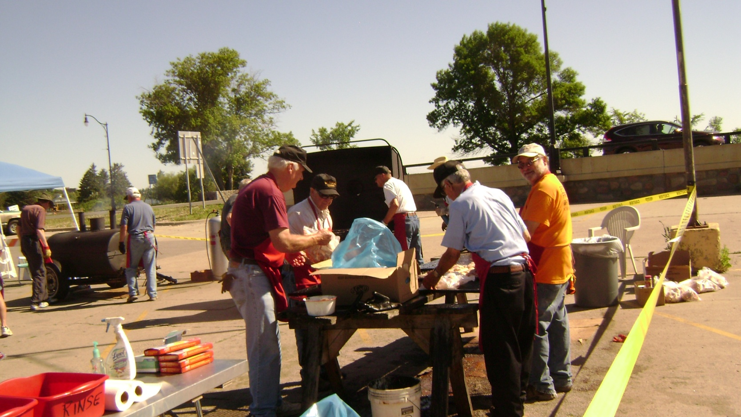
Fundraising Activities
Fundraisers:
Each Lions club has different fundraising traditions. Examples in 5M10 include: pancake days; BBQ meal days; community meals; Cash & Grand prize raffles
Notes:
Trainer Tip: Consider adding photos from the projects to the slide if they are available.

Slide 20
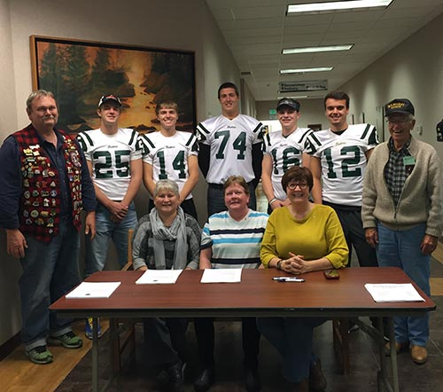
Service Activities
Always Looking For New
Service Projects:
Vision Screening (e.g. Kidsight)
Highway/Community Cleanup
Used Eyeglasses & Hearing Aides Collection
Holiday Season Bell Ringing and Gifts
for Needy
Walk for Guide Dogs Day
Tree Planting & Disaster Relief
Volunteering at local schools

Slide 21
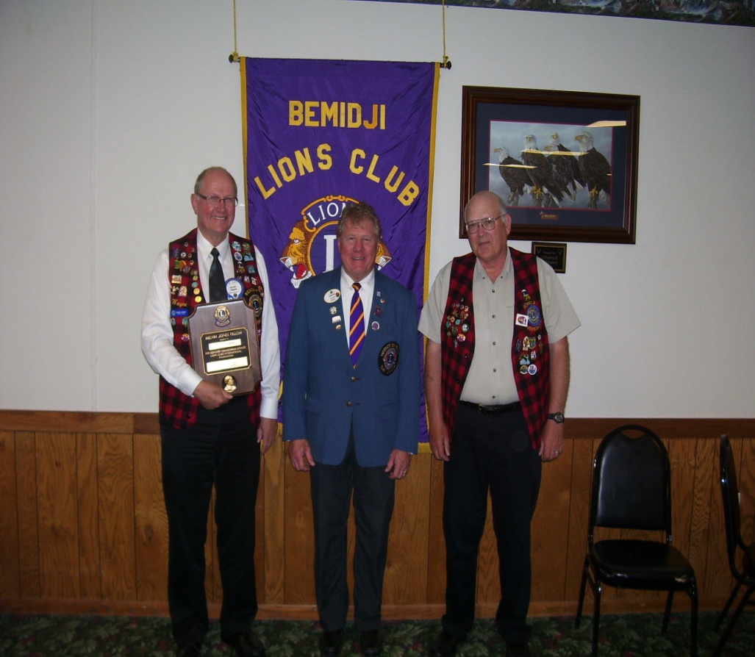
Organizations & Charities Supported:
Lions International (Minnesota)
LCIF & Melvin Jones Awards
MN Lions Vision Foundation (1960)
MN Hearing Foundation (1973)
MN Diabetes Foundation (2009)
MD5M Lions Childhood Cancer Foundation of MN (2019)
Lions Leader Dogs (1939)
Lions Can-Do Canines

Slide 22
Organizations & Charities Supported:
Lions International (Ontario)
LCIF or Lions of Canada Fund for LCIF & Melvin Jones Awards
Lions Eyebank of Manitoba & NW Ontario
Canadian Nat’l Institute for the Blind
Canadian Diabetes Foundation
Lions Foundation of Canada (Dog Guides)

Slide 23
Lions Member Recruitment
Ask One
Ask Family & Friends
Contact community businesses & other
non-profit organizations
Conduct Membership Recruitment Drives &
Contests
Publicize Your Lions Club

Slide 24
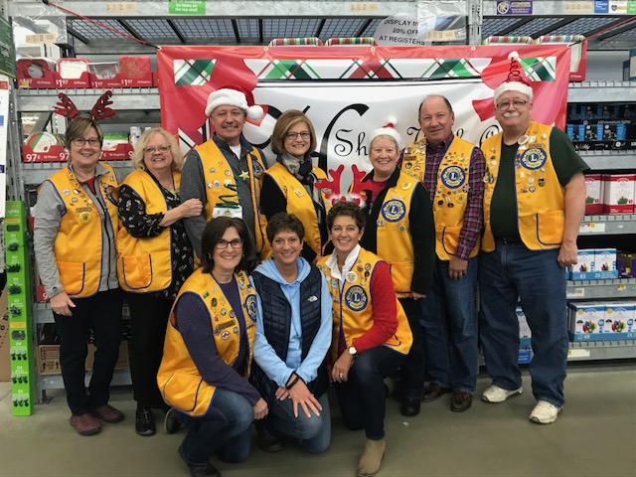
Member Mentoring
Sponsors of new members need to regularly communicate with members they have sponsored
Ask members to share areas of interest, expertise, and things that they are passionate about
Visit LCI Website: Membership Development/Basic Mentoring Guide.
Website: https://lionsclubs.org/resources-for-members/resource-center

Slide 25
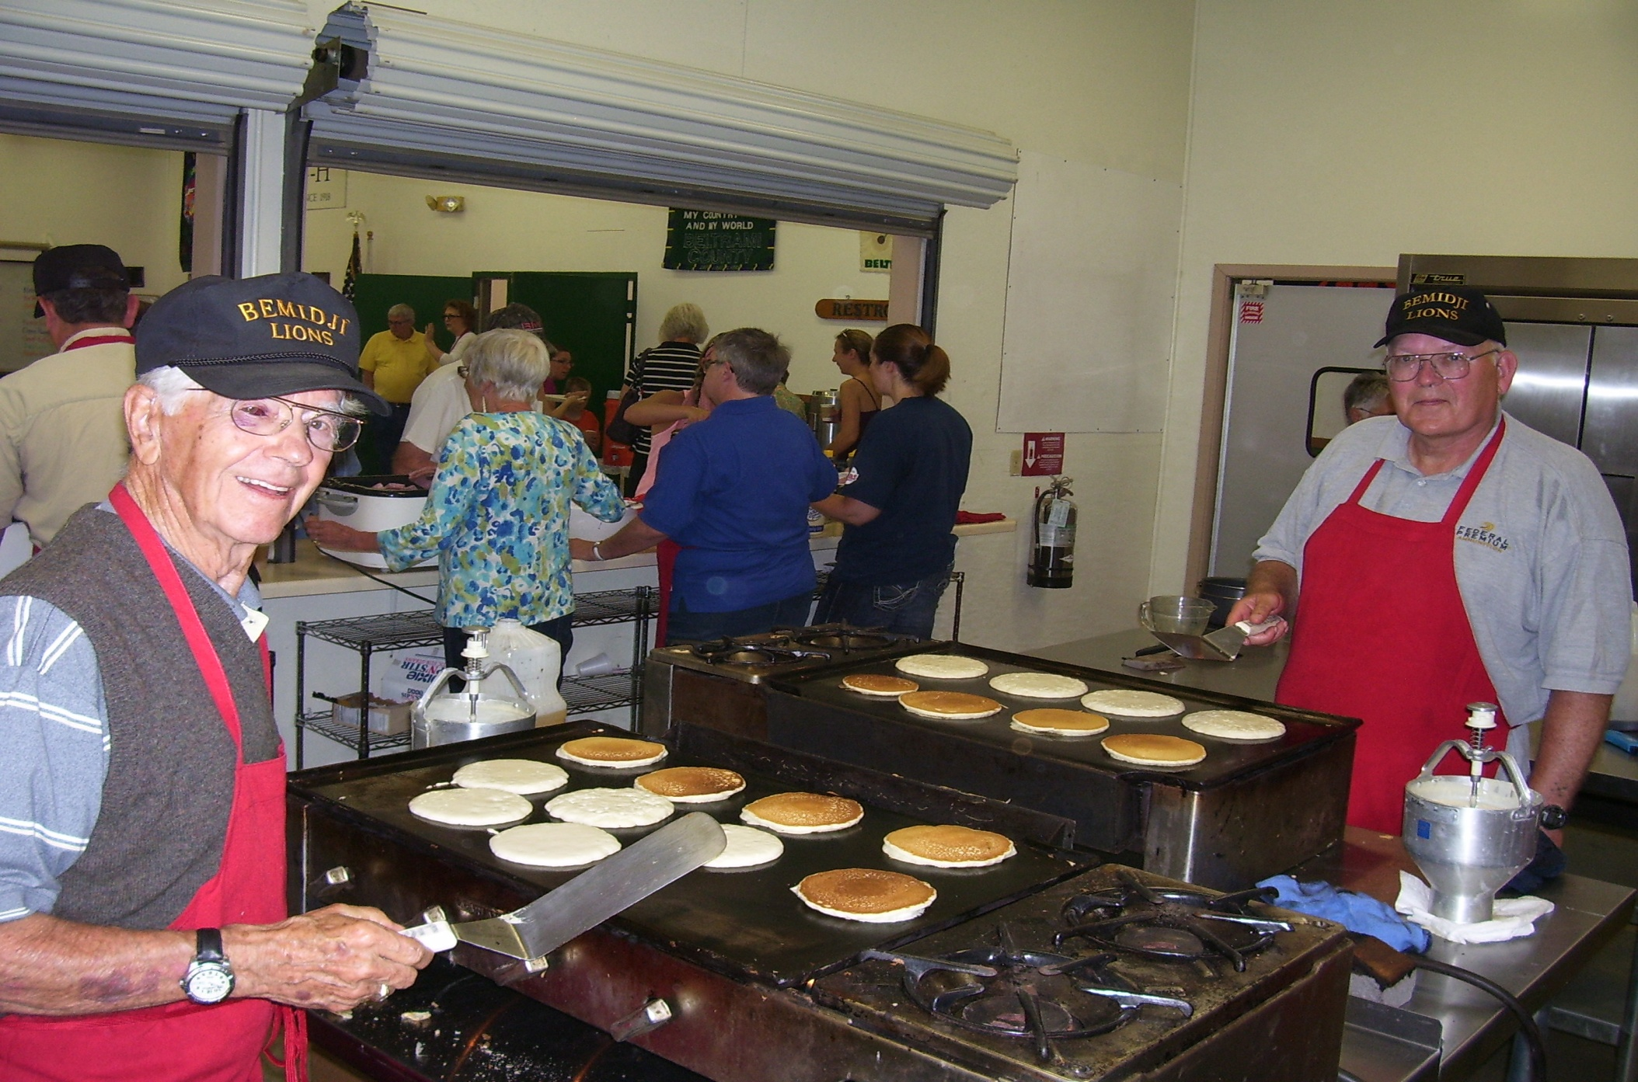
Member Orientation
Any Questions?

