Slide 1
5M10 Lions
Club President Training

Slide 2
Welcome
Congratulations
You have been elected to the position of
Club President

Slide 3
Objectives
This training will provide you with the basic information and resources necessary to prepare you for your new position.
Upon completion of this training, you will be able to:
Recognize the purpose of a Lions club and its placement within the structure of the Lions Clubs International
Summarize the responsibilities of club president
Access additional resources as needed

Slide 4
This training will include:
Introduction
Your Club Leadership Team
Responsibilities of the Club President
Planning Your Term
Resources

Slide 5
Introduction
As president, you will lead your club in service activities that help support your local community and surrounding areas.
However, it’s also important to remember that you are a part of something much bigger.

Slide 6
Structure of Lions Clubs International
Lions Clubs International is comprised of a large network of Lions, with clubs at the center.
This structure facilitates communication and promotes service on a local, regional and global scale.
1
Club

Slide 7
Structure of Lions Clubs International
Constitutional Area
A club consists of a minimum of 20 members
A zone consists of 4 – 12 clubs
A region consists of 10 – 24 clubs (5M10 – 3 regions)
A district is comprised of at least 35 clubs with 1250 active members (5M10 – 46 clubs with 1244 members)
Several districts in a given geographical area comprise a multiple district (MD5M)
Each Lions club is located in one of the seven Constitutional Areas, which is represented by at least one international director (CA1 and CA2)
Multiple District
District
Region*
Zone
Club

Slide 8
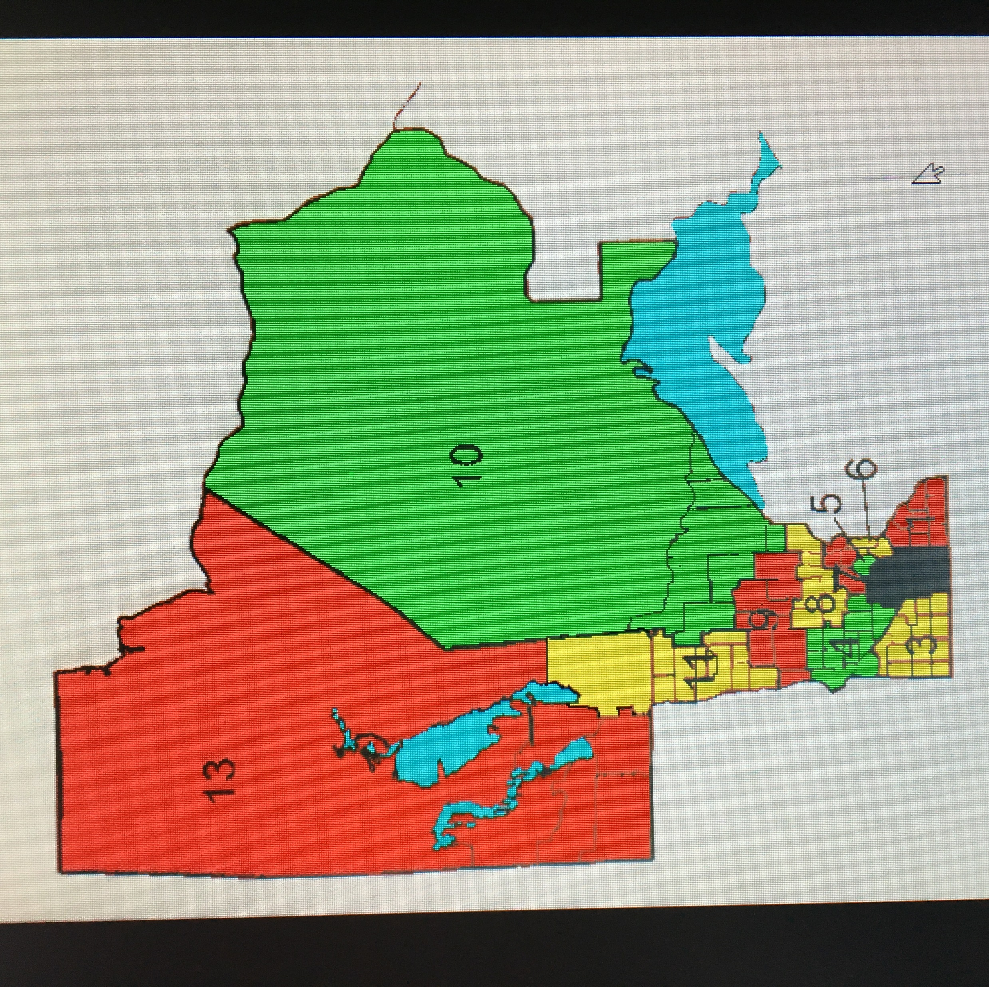

Slide 9
Structure of Lions Clubs International
Constitutional Area
Individual clubs and their members are at the heart of the Association.
Without their commitment to serving others locally, we could not maintain our legacy of global service.
Multiple District
District
Region*
Zone
Club

Slide 10
Introduction
As a club within the greater International Association of Lions Clubs, your mission is:
TO EMPOWER volunteers to serve their communities, meet humanitarian needs, encourage peace and promote international understanding through Lions clubs.

Slide 11
Your Club Leadership Team
As president, you are the chief executive officer of the club.
Club Members
Club Members
Board of Directors
Board of Directors
President
President
Secretary
1st VP
2nd VP
Immediate Past President
Treasurer

Slide 12
Your Club Leadership Team
As president, you are the chief executive officer of the club.
You have limited power (no absolute authority) and your authority to act comes from directives from the board of directors, club members and club’s constitution and by-laws
You work in cooperation and have shared responsibilities with your board of directors
Club Members
Club Members
Board of Directors
Board of Directors
President
President
Secretary
1st VP
2nd VP
Immediate Past President
Treasurer

Slide 13
Your Club Leadership Team
The board of directors includes:
the president
the immediate past president
vice presidents
secretary
treasurer
Lion tamer (optional)
tail twister (optional)
membership chairperson
any other elected directors

Slide 14
Your Club Leadership Team
The board of directors have the following duties and powers:
a. It constitutes the executive board of the club and is responsible for the execution, through the club officers, of the policies approved by the club. All new business and policy of the club shall be considered and shaped, first, by the board of directors for presentation to and approval by the club members at a regular or special club meeting.

Slide 15
Your Club Leadership Team
b. It authorizes all expenditures and should not create any indebtedness beyond the current income of this club, nor authorize disbursal of club funds for purposes inconsistent with the business and policy authorized by the club membership.
c. It has power to modify, override or rescind the action of any officer of this club.
d. It shall have the books, accounts and operations of this club audited annually or, in its discretion, more frequently and may require an accounting or have an audit made of the handling of any club funds by any officer, committee or member of this club. Any member of the club in good standing may inspect any such audit or accounting upon request at a reasonable time and place.

Slide 16
Your Club Leadership Team
e. It appoints, on recommendation of the finance committee, a bank or banks for the deposit of the funds of the club.
g. It shall not authorize, nor permit, the expenditure, for any administrative purpose, of the net income of projects or activities of this club by which funds are raised from the public.
h. Support Board of Directors decisions.

Slide 17
Your Club Leadership Team
It maintains at least two (2) separate funds governed by generally accepted accounting practices:
Administrative (Lions) money - to record administrative monies such as dues, tail twisting fines and other internally raised club funds.
Activity (Public) money - to record activity or public funds raised by asking support from the public.
Disbursement from such funds shall be in strict compliance with Section (g) of this article.

Slide 18
Your Club Leadership Team
NEW:
Club Administrator
Club Administrators can perform all of the same tasks in MyLCI as club secretaries. The club president or club secretary may assign a Club Administrator…see My Lions Club >> Officers.

Slide 19
Responsibilities of the Club President
As club president, your primary responsibilities include…
presiding at all club and board meetings
Issuing the call for regular and special meetings of the board of directors and club
Appointing Committee Chairs and members
Ensuring that regular elections are duly called, noticed and held
Attend Cabinet, Zone and Region Meetings as appropriate
Report at Zone Meetings

Slide 20
Responsibilities of the Club President – Effective Meetings
There are 3 phases to managing an effective meeting.
Preparation
Facilitation
Follow-up

Slide 21
Responsibilities of the Club President – Effective Meetings
Phase 1 - Preparation
With the help of your club secretary, you will:
Give advance notice of meeting dates/times
Select a program for the benefit of the club members
Prepare a well planned agenda, distributed in advance
Have a good understanding of parliamentary procedures
Ensure the facilities used are adequate for your meeting purposes

Slide 22
Responsibilities of the Club President – Effective Meetings
Phase 1 - Preparation
Why an agenda….it is the ‘Blueprint’ for productive and effective meetings! Your agenda ensures:
Meetings kept on track and follow timelines
Meetings are orderly and productive
Members are informed
Issues are not overlooked

Slide 23
Responsibilities of the Club President – Effective Meetings
Phase 1 - Preparation
Preparing the agenda:
Work with Secretary, Vice Presidents, Committee Chairs
Review past meeting minutes
Send out agenda prior to meeting (Secretary)
Have copies at the meeting (Secretary)

Slide 24
Responsibilities of the Club President – Effective Meetings
Phase 1 - Preparation
Resources:
Lions Club International Resource Center:
Meeting Management Resource
Time Management Resource
Web workshops
Lions University Course 104 – Effective Club Meetings

Slide 25
Responsibilities of the Club President – Effective Meetings
Phase 2 - Facilitation
Facilitating a meeting takes skill.
Follow the agenda….start and end the meeting on time
Follow the agreed upon parliamentary procedure for conducting business
Robert’s Rules of Order is suggested system
Call to order; kinds of motions; debate/discussion; voting; table/rescind/reconsider motions; recognize speakers; etc.

Slide 26
Responsibilities of the Club President – Effective Meetings
Phase 2 - Facilitation
Facilitating a meeting takes skill.
Make the meeting fair for everyone
Avoid political or religious discussions
Treat everyone with respect and kindness

Slide 27
Responsibilities of the Club President – Effective Meetings
Phase 2 - Facilitation
Recognize there may be times when conflict arises. Remember:
The President or VP is the standing authority and must understand how to manage these types of situations.
One needs to develop the ability to assert oneself when necessary and sometimes deal with disharmonious behavior.
Also, one should abide by some common courtesies.

Slide 28
Responsibilities of the Club President – Effective Meetings
Phase 2 – Facilitation
RESOURCES:
Robert’s Rules of Order
Lions Clubs International Resource Center:
Club Dispute Resolution Procedures
Club Dispute Resolution Guidelines
Conflict Resolution Webinar & Participant Book

Slide 29
Responsibilities of the Club President – Effective Meetings
Phase 3 – Follow-up
With the help and cooperation of the club secretary:
Follow up on the action items in your meeting – or follow up with those that promised to complete a task.
Send out the meeting minutes and agenda for the next meeting.
Acknowledge and thank those that assisted the club and/or fulfilled their commitments.

Slide 30
Responsibilities of the Club President - Committees
As president, you will work in cooperation with the chairpersons of committees to effect regular functioning and reporting.
There are two categories of committees:
Administrative
Activities

Slide 31
Responsibilities of the Club President - Committees
Here are some common Administrative Committees.
Administrative Committees
Administrative
Constitution and By-Laws
Attendance
Leadership Development
Greeter
Lions Information
Membership
Program
Information Technology
Public
Relations and
Communication
Finance

Slide 32
Responsibilities of the Club President - Committees
Here are some common Activities Committees:
Activities Committees
Activities
Sight Preservation Awareness & Action
Hearing Preservation Awareness & Action
Environmental Services
Community Services
Disaster Preparedness
Diabetes Awareness
Lions Services for Children
Lions Opportunities for Youth
International Relations

Slide 33
Responsibilities of the Club President - Committees
Additional committees may be added as necessary
Committee chairpersons are appointed by the president, with the exception of the Membership Chairperson and Membership Committee, who are elected.
It is important that you confer with the 1st and 2nd vice presidents as they will be working closely with the committees.

Slide 34
Responsibilities of the Club President - Committees
Choosing the right chairperson and committee members is important for several reasons.
It makes your term as president more productive and effective
Committee membership or chairperson roles prepare members for club officer positions
Allows members to use their skills and talents and will help keep them motivated and invested in the club

Slide 35
Responsibilities of the Club President - Committees
Choosing the right chairperson and committee members is important for several reasons. Consider those that:
Choosing a Chairperson
Have expressed a desire to lead
Are dependable
Can get along well with others and delegate responsibility
Will agree to have a co-chairperson if deemed necessary
Will easily take direction and work well with others

Slide 36
Responsibilities of the Club President - Elections
Next let’s look at Elections:
The president needs to appoint a nominating committee, which will submit the names of the candidates for club officers to the club at the nomination meeting.
The nomination meeting is held in March. Club members must be informed of the meeting at least 14 days in advance.
An election meeting needs to take place in April. Notice of the meeting should be sent to club members 14 days in advance and should include the names of all approved nominees.

Slide 37
Responsibilities of the Club President - Elections
ADDITIONAL RESOURCES:
Lions Club International
Standard Club Constitution and By-Laws
The Club Election Guidelines

Slide 38
Responsibilities of the Club President – Beyond Your Club
The last topic to cover under responsibilities is your commitment beyond your own club.
Zone meetings
Cabinet meetings
Global Leadership Team
Global Membership Team
Mid-winter conventions
Multiple conventions

Slide 39
Responsibilities of the Club President
The Lions Learning Center offers free online courses to assist members with leadership development.
Additional Resources
Topics include:
Meeting Management
Conflict Resolution
Decision Making
Delegation

Slide 40
Planning Your Term
Before you officially take office, there are a several steps you can take to better prepare yourself.
Preparing for your Term
Attend Club Officer Training
Meet with the current president to discuss matters that will continue into your club term
Set goals:
Review the Blueprint for a Stronger Club
Review the Club Excellence Program
Review the requirements for the Club Excellence Award

Slide 41
Planning Your Term
You will also need to…
Preparing for your Term
Choose committee chairpersons
Work with your treasurer and Finance Committee/Board of Directors to:
Prepare the administrative and activities budgets
Review banking institution and petty cash reimbursement guidelines
Establish club dues based on the amount needed to maintain the financial health of the club
Develop a plan for the year
Calendar of events
More formal planning process – Club Excellence Program
Be ready to ‘hit the ground running’ on July 1st!

Slide 42
Planning your Term
As your term progresses, be sure to…
Ongoing
Conduct regular meetings
Communicate frequently to ensure members are up to date with club news and issues
Handle correspondence promptly
Try to maintain a 24 hour standard
Try to handle correspondence once
Help select service projects
Recruit new members
Attend zone meetings and conventions
Review monthly membership and activity reports

Slide 43
Planning your Term
You will still play an important role in the future success of the club by planning for an effective transition.
Transition to the next leadership team
Meet with the incoming president to discuss the status of the club and any plans or projects that are not yet completed
Plan the Year-End Recognition/Appreciation Dinner
Plan the Annual Meeting/Installation Dinner
Apply for Club Excellence Award
End of Term

Slide 44
Planning your Term
Before we finish…
Additional Resources
Explore the Lions Learning Center
www.lionsclubs.org – resources for members
On-line courses
Lions University
Down-load resources
Talk to a Lion Leader
Past presidents
Your District team

Slide 45
Planning your Term
Leadership….things to keep in mind!
Build a shared vision among Club members
Guide/encourage members toward reaching Club goals and personal goals
Provide leadership opportunities
Be aware of leadership training
Encourage attendance at training
Develop a mentoring program
EVERY member has an important role to fill
Lead by example

Slide 46
Planning your Term
Before we finish…
What goals do you hope to achieve during your term as club president?

Slide 47
Thank you for participating.
If you have any questions, please contact:
Lion Wendy Wiedenhoeft – wendyparkin@shaw.ca
1st VDGE Susan Winner – spb0301@gmail.com
2nd VDGE Jodi Caul - jodicaul@gmail.com
PDG Angela Sharbot – a_sharbot@hotmail.com

Slide 48
Very best wishes for a successful term as Lions Club President!

